Slide 1
HEVC sub-pixel interpolation and
Image super-resolution
2019 spring - ECEN 642 Class project
Yixu Chen
05 / 03 / 2019

Slide 2




What is super-resolution
Input
Bicubic
SRCNN
Original

Slide 3

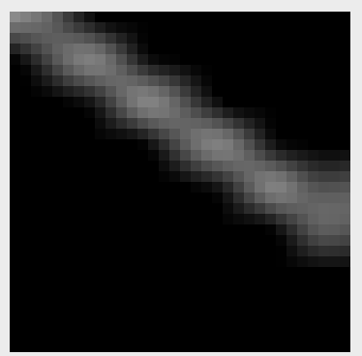
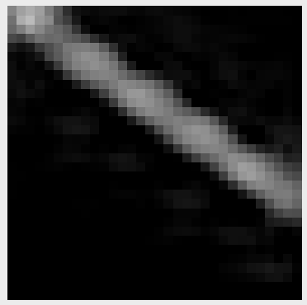


Input
Bicubic
SRCNN
Original
HEVC

Slide 4
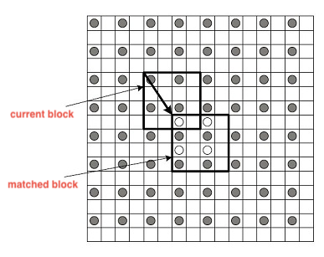
Idea
In HEVC video coding standard, the intre-prediction between picture need sub-pixel level accuracy for motion estimation.
HEVC currently using 1/4 precision for luminance and 1/8 precision for chrominance.
In this work we compare a few convolutional neural networks methods for single image super-resolution and the HEVC’s 7 and 8 taps ﬁlter for sub-pixel interpolation.

Slide 5
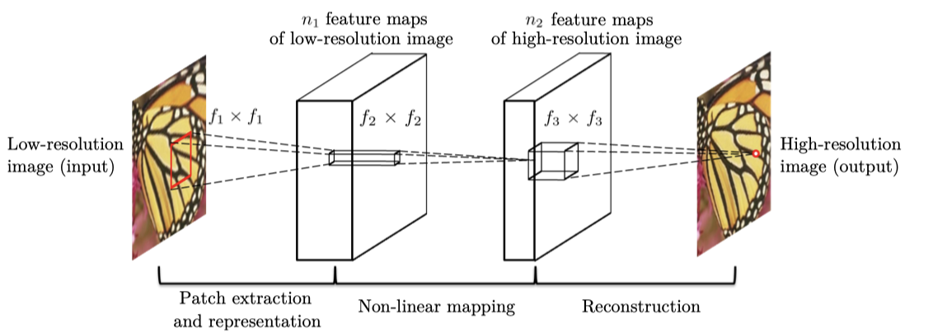
SRCNN
Fully feed-forward convolutional neural network that learns an end-to-end mapping between low and high-resolution images
With little pre-processing or post-processing beyond the optimization
The original low resolution(LR) images are upsampled to the desired size using traditional bicubic interpolation method
And then go through 3 layers of CNN to refine the high frequency detail.

Slide 6
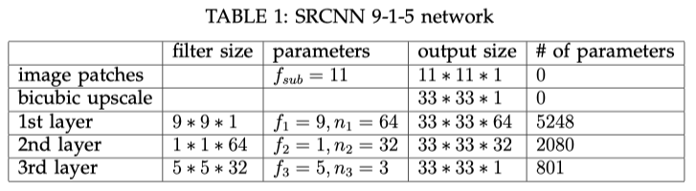
SRCNN
Total params: 8129

Slide 7
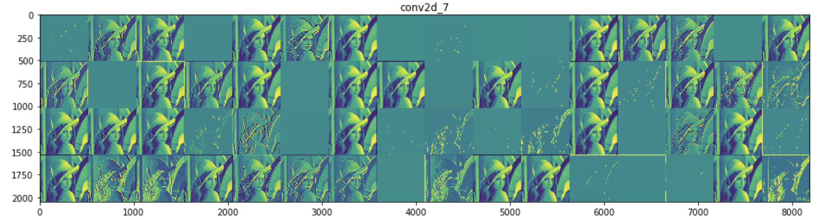
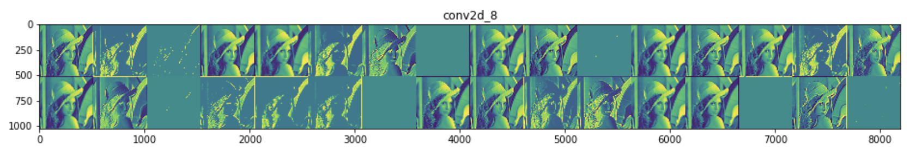
SRCNN

Slide 8
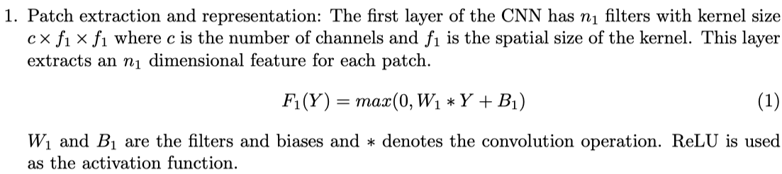
SRCNN

Slide 9
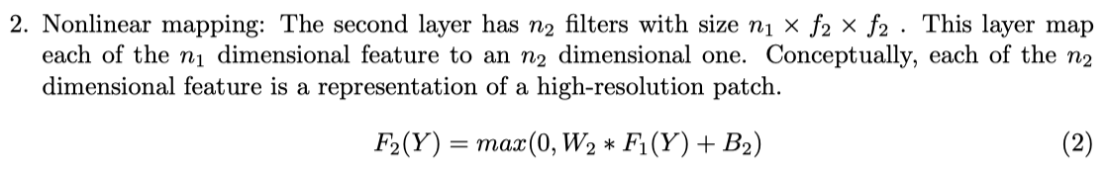
SRCNN

Slide 10
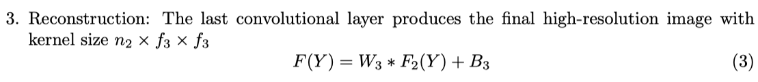
SRCNN

Slide 11
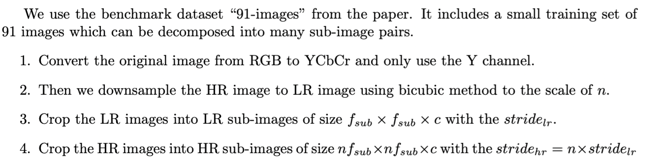
SRCNN Training

Slide 12
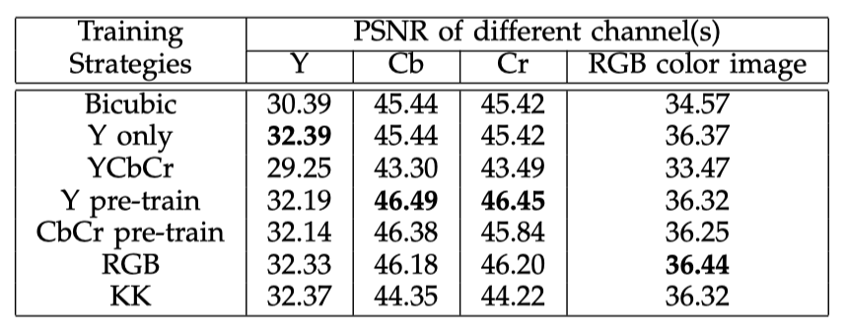
SRCNN Training

Slide 13
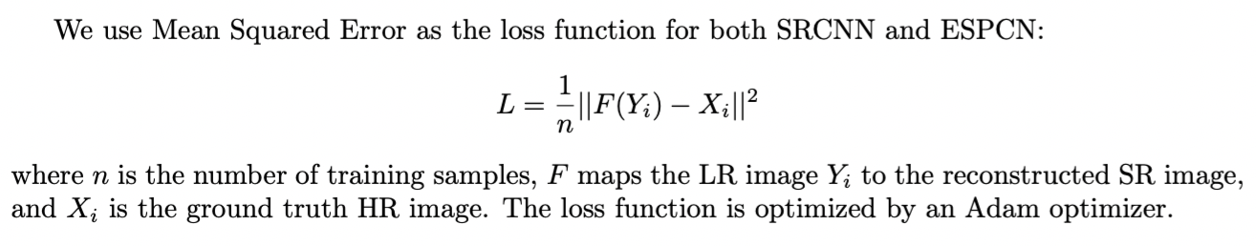
SRCNN Training
For SRCNN, 500 epochs and an initial learning rate η = 1 × 10⁻⁵ are used.

Slide 14
However, increasing the resolution of the LR images before the image enhancement step increases the computational complexity.

Slide 15
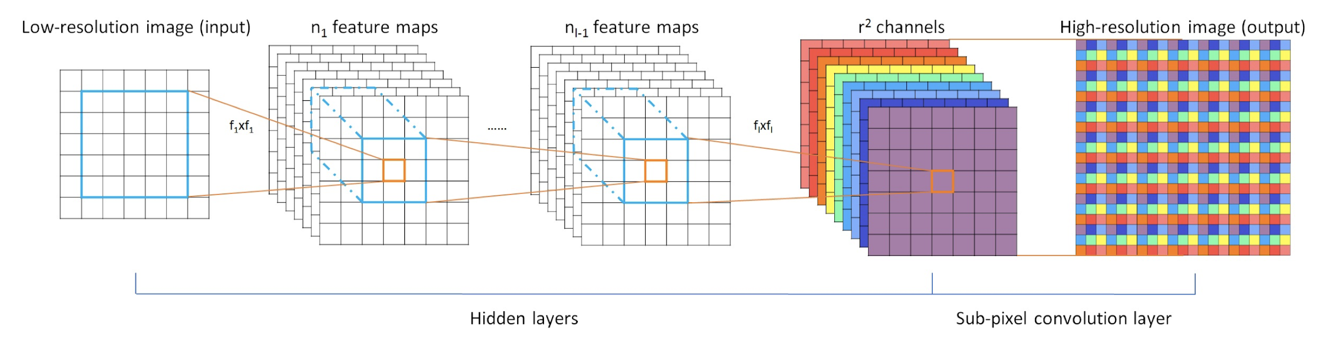
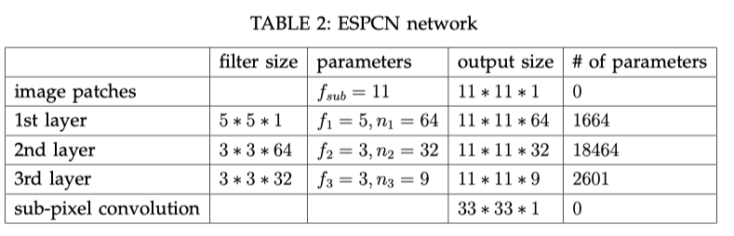
ESPCN
Total params: 22,729

Slide 16
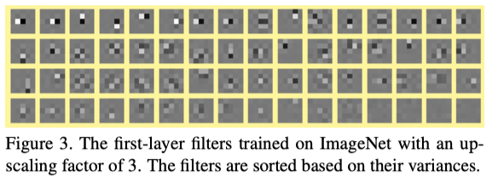
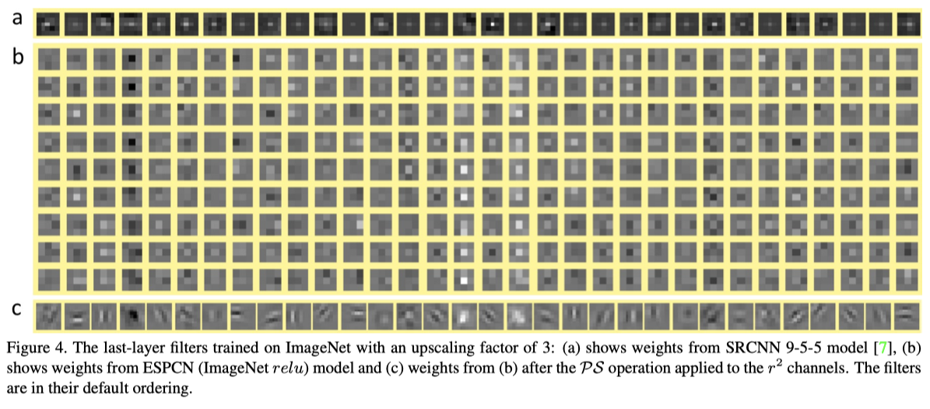
ESPCN

Slide 17
ESPCN
To avoid upscaling LR image before feeding it into the network. ESPCN first apply a 3 layers convolutional neural network directly to the LR image,
Then apply a sub-pixel convolution layer that upscales the LR feature maps to produce the HR image.
The calculation is significantly reduced as the feature calculation is done in LR space with less pixels to calculate.

Slide 18
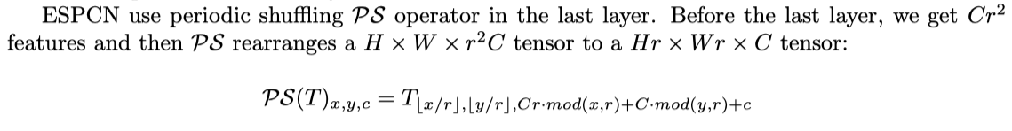
ESPCN

Slide 19
ESPCN Training
Using 91-images dataset for training, using Set5 and Set14 for testing
To synthesize the low-resolution samples LR , we blur HR using a Gaussian ﬁlter(simulating camera’s point spread function) and sub-sample it.
The sub-images are extracted from original images to ensure that all pixels in the original image appear once and only once as the ground truth of the training data.
We have 10087 sub-images for scale 4 and 19382 sub-images for sclae 3.
Initial learning rate is set to 0.01 and ﬁnal learning rate is set to 0.0001 and updated gradually when the improvement of the cost function is smaller than a threshold µ.
It took 3 hours on an GTX 970 GPU to do training on 91-images.

Slide 20
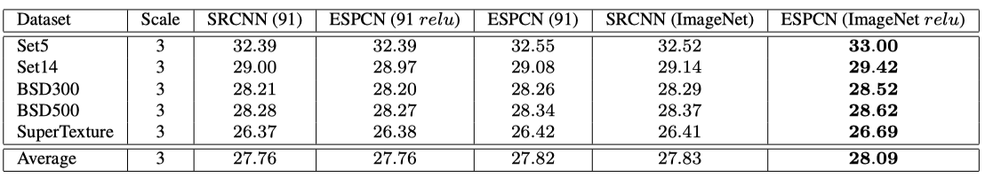
ESPCN Training
We choose tanh instead of relu as the activation function.

Slide 21
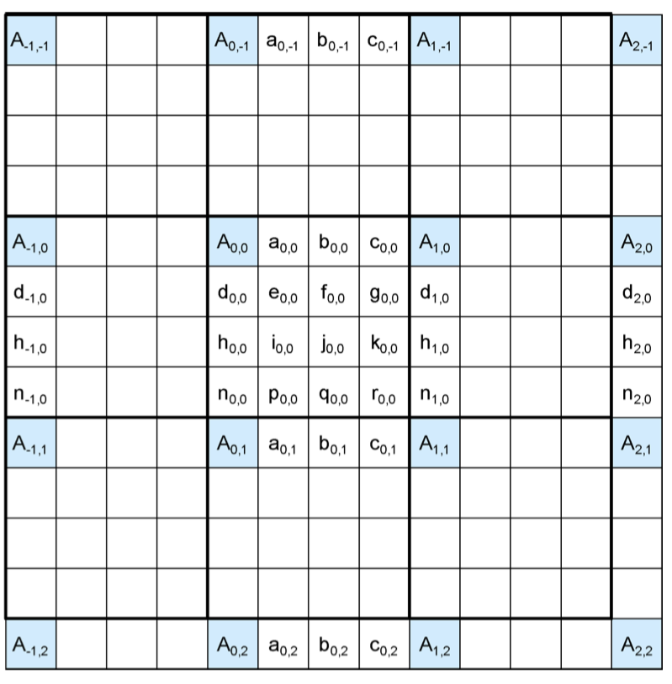
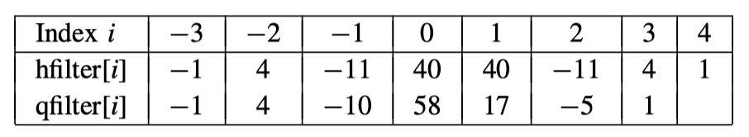
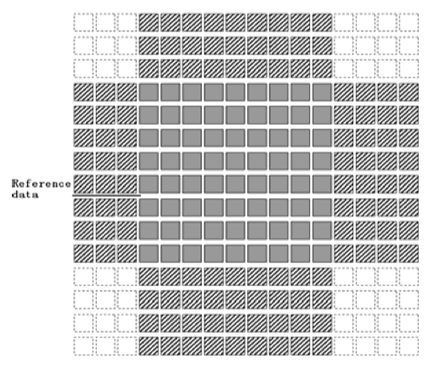
HEVC interpolation

Slide 22
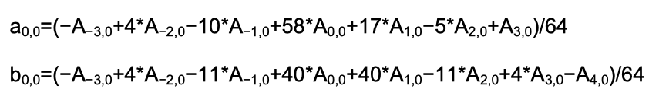
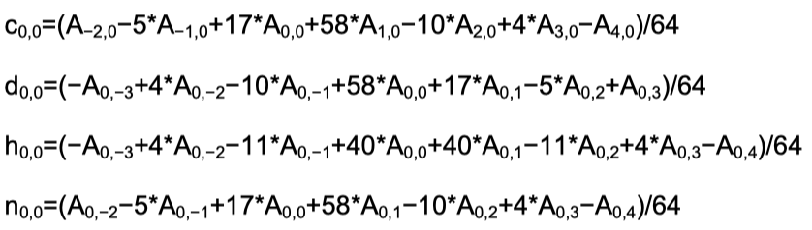
HEVC interpolation
the positions labeled with uppercase letters, Ai,j , represent the available luma samples at integer sample locations.
Whereas the other positions labeled with lower-case letters represent samples at non-integer sample locations, which need to be generated by interpolation.

Slide 23
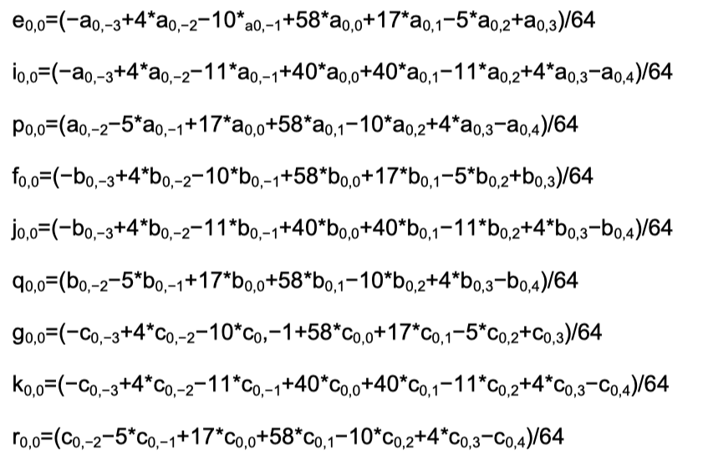
HEVC interpolation

Slide 24







Scale 4 Result
Original
Input
Bicubic
HEVC
SRCNN 9-1-5
SRCNN 9-5-5
ESPCN

Slide 25
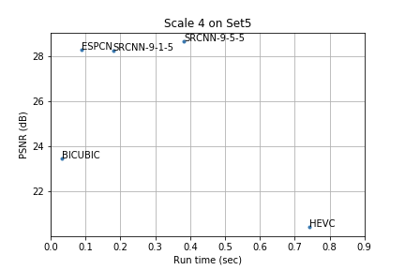
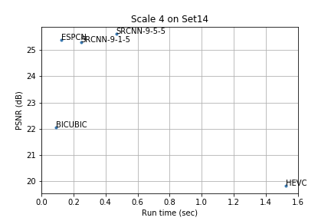
Scale 4 PSNR vs. Run Time

Slide 26
Scale 4 PSNR vs. Run Time
SRCNN 9-5-5 learns better than 9-1-5
This is because 9-5-5 uses larger ﬁlter size in the middle layer and has more parameters and this will enlarge the reception ﬁeld from (9+5−1) ² = 196 to (9+5−1+5−1) ² = 289.
The reception field in HEVC is only 7 or 8 pixels
Utilizing more neighborhood information in the mapping stage is beneﬁcial to the network performance as well as increase the computation needed to run the network.

Slide 27
Scale 4 PSNR vs. Run Time
The speed of predicting a HR image from a LR image determines whether it can be used in video and codec. Apparently, there is a trade off between PSNR and Run Time.
SRCNN 9-5-5 have the highest PSNR but it’s slow
My implementation of HEVC interpolation use python and have no optimization while in the video coding standard they have speciﬁc hardware for this tasks. However, the performance of HEVC DCTIF is not as good as expected.
The ESPCN is not only fast but also have great performance which is almost the same as SRCNN 9-5-5.
ESPCN have the best overall performance although it’s harder to train than SRCNN.

Slide 28
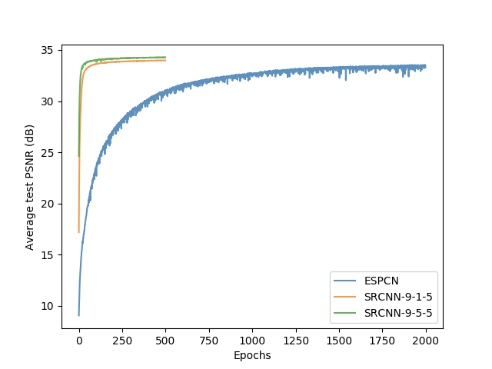
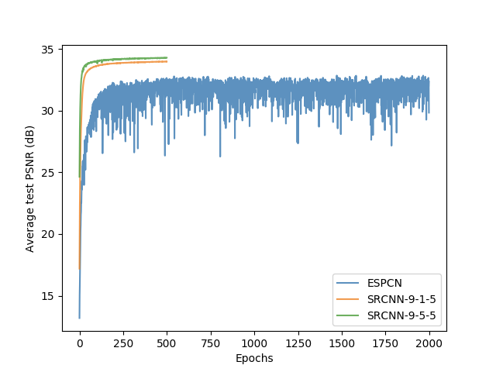
PSNR vs. epoch
Scale 3 Training history with different learning rate
ESPCN 10⁻⁴ learning rate
ESPCN 10⁻³ learning rate

Slide 29
PSNR vs. epoch
Scale 3 Training history with different learning rate
it takes 2000 epochs for ESPCN to achieve the same PSNR as SRCNN indicating that ESPCN is much harder to learn than SRCNN
ESPCN 10⁻⁴ learning rate

Slide 30
PSNR vs. epoch
Scale 3 Training history with different learning rate
The loss function PSNR is jumping around the local minimum. Training can’t converge due to the large learning rate.
ESPCN 10⁻³ learning rate

Slide 31
We have compared two different models of image super-resolution, SRCNN and ESPCN, with the traditional Bicubic and HEVC methods.
Both PSNR and run time of the SRCNN model scale with the number of parameters, as can be seen by comparing SRCNN 9-1-5 with SRCNN 9-5-5 where the latter has more parameters.
SRCNN 9-5-5 is the best super-resolution among all the methods we tried. However, due to the upscaling is at the front of the network. The speed is not fast enough to be useful for video super-resolution.
From ESPCN result, we know that there is a trade-off between quality (measured by PSNR) and run time. If the time cost is negligible, earlier deconvolution makes the HR image reconstruction better.
ESPCN can achieved fast speed and relatively good performance.
From the result we can see that HEVC interpolation isn't good enough. If we can use ESPCN in video codec for sub-pixel interpolation, the accuracy of motion estimation and motion compensation can be further improved.
The draw back for NN SR is for each scale a separate model have to be trained.
Conclusion

Slide 32
Thank you for listening

